Slide 1
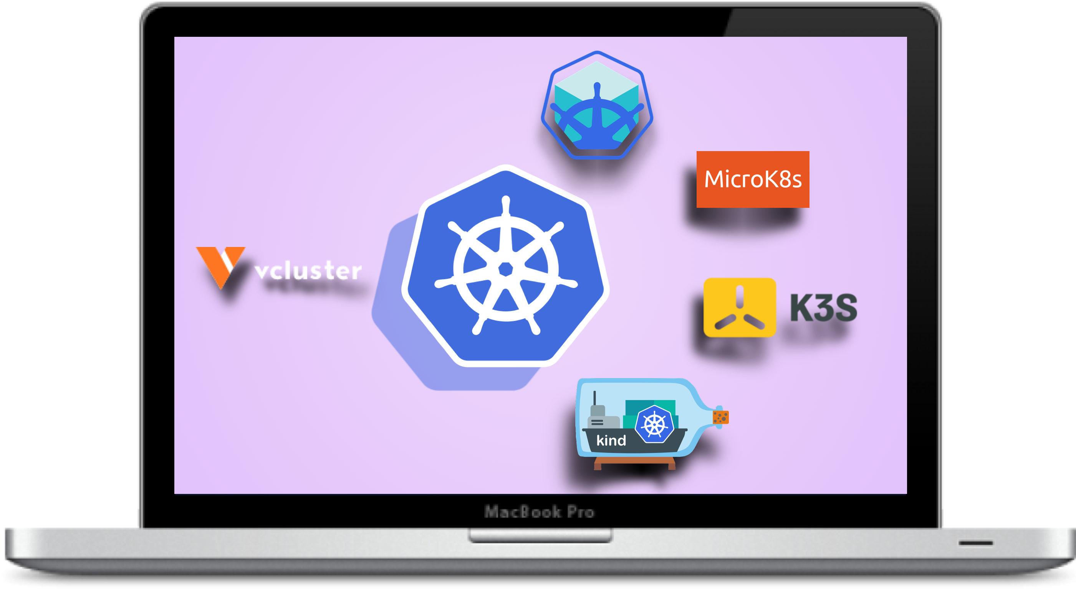
CYOK
Choose Your Own Kubernetes
For Local Development
#ospocon
@gkarthiks
Notes:
Welcome to OSPO Con
I am going to talk about Choosing the Kubernetes clusters for local development

Slide 2
About me
Karthikeyan Govindaraj
OpenSource Enthusiast | Writer | CNCF Speaker
Developer Evangelist @ BlackRock
https://bio.link/gkarthiks
https://gkarthiks.medium.com
@gkarthics

Slide 3
Concepts
Single Node Cluster: A complete Kubernetes services viz., kube-apiserver, etcd, kube-scheduler, kube-controller-manager running in a single instance of a machine
Multi Node Cluster(HA): A Kubernetes cluster which has multiple worker nodes for workload scheduling, providing HA for the deployed service
HA Control-Plane Cluster: A Kubernetes cluster with multiple worker nodes for deployed workload HA and multiple control-plane node for the Kubernetes cluster HA itself
@gkarthics
Notes:
At a high level, a cluster is a group of two or more computers, or nodes, that run in parallel to achieve a common goal
For Admins
•Control plane is always available
•More than one nodes
•Workloads spread across nodes
•Reliable persistent storage
For K8s
•Datastore is always available
•Clustering
•Persistent storage configured
•Load balancer floating IPs

Slide 4
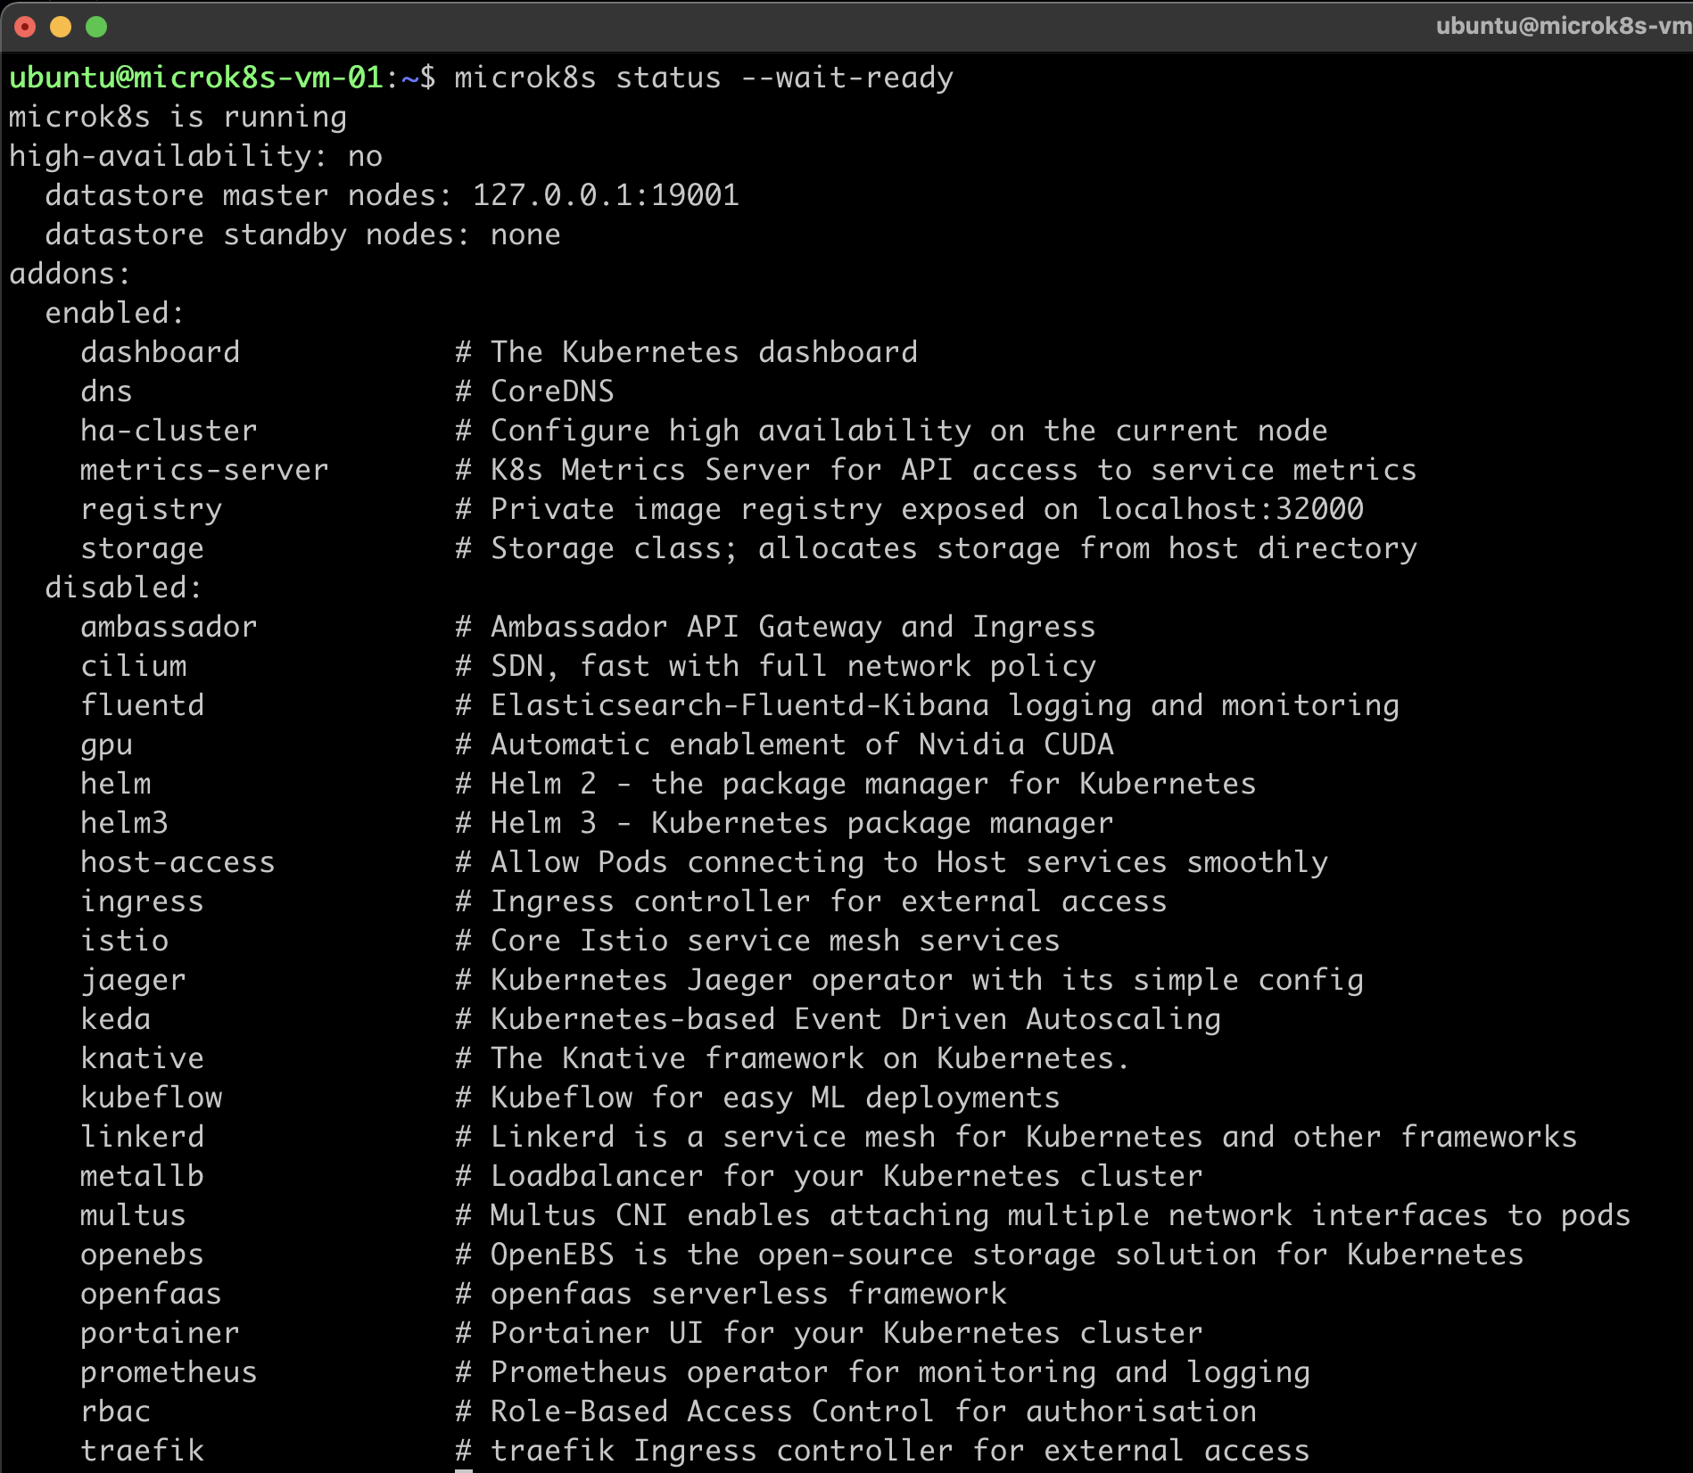
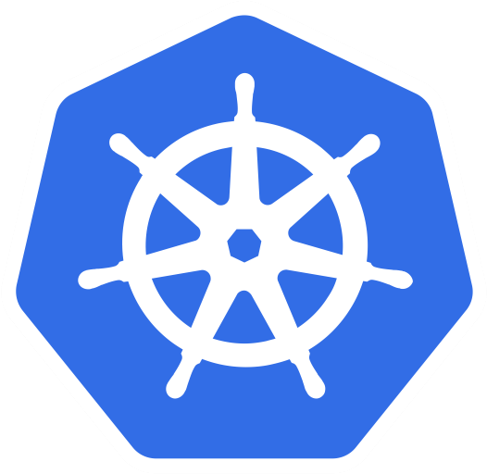
microK8s
Creates a single/multi node cluster
Built-in container registry as add-on
Start Kubernetes
microk8s install microk8s status --wait-ready
microk8s enable dashboard dns registry
microk8s kubectl get all -A
alias kubectl="microk8s kubectl"
@gkarthics |
Notes:
Standalone or clustered
It has a built-in registry add-on, wehrn enabled deployed the local cluster registry as well on port 5000
To start the microk8s Kubernetes cluster, execute the following commands
The –wait-ready flag is to wait for the Kubernetes services to initialize
Enable dashboard, dns and registry will enable the corresponding addons
Since its on the local machine, to directly use the kubectl command, you can just create a alias command

Slide 5
microK8s ....High Availability
Easy multi-node setup
multipass can be used for managing VMs
multipass launch --name microk8s-vm-01 --mem 4G --disk 40G
multipass launch --name microk8s-02 --mem 4G --disk 40G
multipass launch --name microk8s-03 --mem 4G --disk 40G
@gkarthics |
Notes:
To create a multi-node cluster, create multiple multipass VM
Install the microk8s via snap in all the machines
Execute add-node command, this will create the token and makes the current machine as the control-plane
Dqlite: the most popular embedded database made distributed

Slide 6
microK8s ....High Availability ….contd
Exec into VM via `multipass shell <control-plane vm-name>`
snap install microk8s in all VMs
Create join token - `microk8s add-node`
@gkarthics |
Notes:
To install mictok8s in VM, you can use the snap package manager
Executing the join command from the rest of the nodes will attach the nodes to the prev selected control-pane

Slide 7
microK8s ....High Availability ….contd
with the `add-node` command
enables HA
creates join token
adds the node to the cluster
Run the command in other VMs - `microk8s join` to join the cluster
Highly Available Cluster is ready

Slide 8
microK8s ....Usage
enable dashboard: “microk8s enable dashboard”
setup kubeconfig: “multipass exec microk8s-vm-01 -- sudo /snap/bin/microk8s.config > kubeconfig”
run from local: kubectl --kubeconfig=kubeconfig get all --all-namespaces
proxy local: kubectl --kubeconfig=kubeconfig proxy
@gkarthics |
Notes:
To use the Kubernetes dashboard for microK8s, there’s an addon similar to the minikube
Enable that via microk8s enable dashboard command
To interact with the local machine, the Kubeconfig can be copied over to the local and a can also serve kubeproxy from local using that kubeconfig

Slide 9
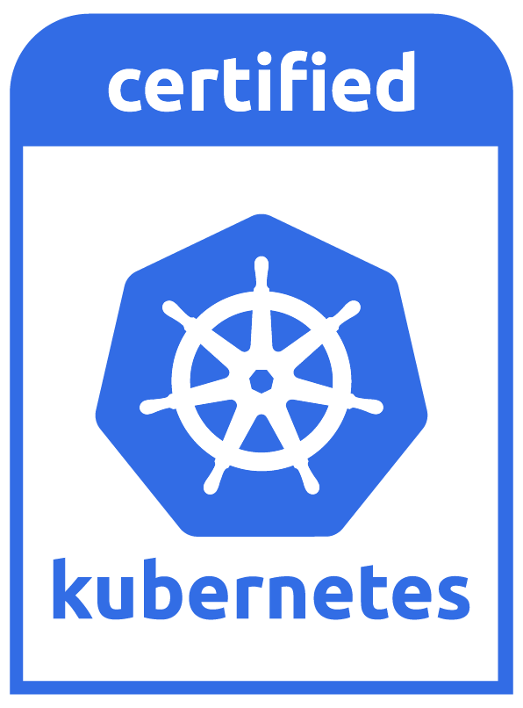
microK8s ....Observation
No need of docker daemon to run locally
Can run in all OS viz., Win, Mac, Linux
Built-in container registry for Images
Well suited for CI environment
Supports Windows containers
@gkarthics |
Notes:
To use microK8s,
there is no need to have a docker daemon running locally.
This can run in almost all the operating systems.
There os a built-in container registry for the local image pull/push.
Well suited for CI but we need to monitor for clean up and resources
Additionaly, this is a CNCF Conformant k8s distribution. Suports windows containers as well.

Slide 10
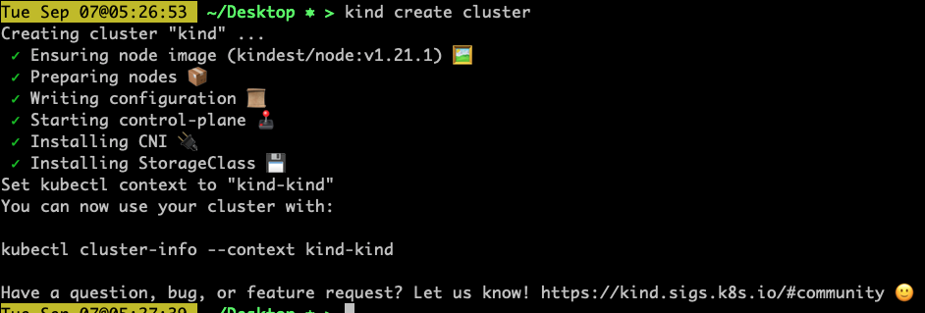
kind
Creates a single/multi node cluster
Follows the concept of Kubernetes In Docker
Owned by k8s SIG
Working with cluster
kind create cluster
@gkarthics |
Notes:
Kind - is from the creators of the very own Kubernetes as well
This follows the concept of KinD
To work with the kind cluster, just execute
Kind create cluster. -> This will create a single node kind cluster. As in the single node Kubernetes cluster inside a docker container.

Slide 11
kind …features
Create a custom build of K8s: “kind build node-image”
Create & Run custom built k8s cluster “kind create cluster --image <img>”
supports Linux,
macOS and Windows (with docker daemon)
@gkarthics |
Notes:
Build the node image which contains Kubernetes build artifacts and other kind requirements
--arch string architecture to build for, defaults to the host architecture
--base-image string name:tag of the base image to use for the build (default "docker.io/kindest/base:v20210521-82de8f15")
--image string name:tag of the resulting image to be built (default "kindest/node:latest")
--kube-root string path to the Kubernetes source directory (if empty, the path is autodetected)
--type string build type, default is docker (default "docker")

Slide 12
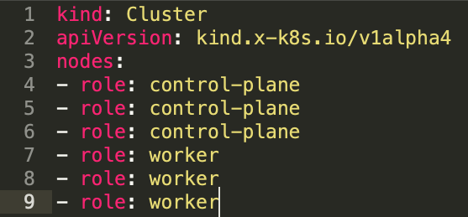
kind …features
Images can be loaded from local build
Allows locally built image to directly run inside K8s cluster
Supports kind configuration file
Creates multi-node and control-plane HA cluster
@gkarthics |
Notes:
The images from the local machine can be loaded directly into the cluster
This helps in directly running the locally built images to immeditealy deploy and test in k8s cluster | similar to minikube
Kind also supports a configuration file to create complex clusters
We can also create a multi-node ha control-plane cluster as well and it will look something like this

Slide 13
kind ….Observation
Needs docker/podman on the host
Runs in all OS viz., Win/Mac/Linux provided docker daemon is available.
Additional deployment for lib/registry to run container registry for Images
Well suited for CI environment
Doesn’t support Windows containers
@gkarthics |
Notes:
The final observation with the Kind clusters are
In order to run Kind we must need either docker or podman in the local machine
Kind can run in all Operating system povided docker/podman is available
Since this creates the pure k8s cluster, if there’s need for registry we need to deploy one manually
This is very well suited for CI environments to quickly execute the integration tests
Though Kind is CNCF conformant, it has few known limitations. One of that is, it cannot support windows containers. Definitely not for production grade orchestration.

Slide 14
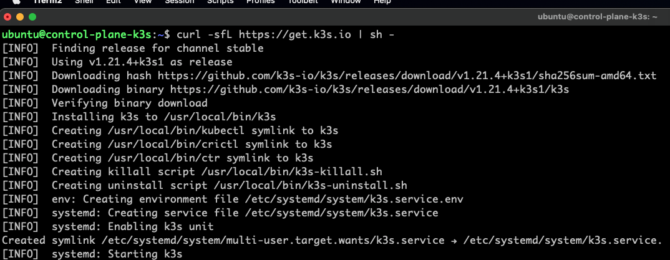
k3s
Can be installed directly only on Linux
Needs either a VM in local machine or k3d
multipass can be used for VMs
@gkarthics |
Notes:
K3s – a stripped down version of Kubernetes.
The biggest downside of this is, it supports only linux machines
So need to have either a virtual machine or k3d
To create virtual machines, tools like multipass or vagrant can be used.
In the virtual machine, just run the script to install k3s and start the cluster

Slide 15
K3s …..multipass
Installs traefik by default
Simply export the config to access from local host
@gkarthics |
Notes:
Few advantages include
Instlation of trafeik by defaut
To interact with the k3s cluster created in avirtual machine, just
Get the VM IP address
Grab the k3s.yaml file and change the loopback address to VM ip address
Now the local kubectl command in the host machine will interact with the k3s cluster with its above extracted kubeconfig

Slide 16
K3s multipass ….High Availability
K3s can also be run in HA mode
Follow same process to create multiple VMs
Get the control-plane token from “/var/lib/rancher/k3s/server/node-token” & control-plane IP address
Set the token to the env variable “K3S_TOKEN”
Install k3s via script with token(automatically picked) and IP arguments as
curl -sfL https://get.k3s.io | k3S_URL=https://<control-plane-IP> sh -
@gkarthics |
Notes:
So far we saw the k3s in single node cluster.
K3s can also be run with multi-node mode as well
To create a multi node cluster,
Create multiple VM in the same process
Coose a machine as control-plane and extract the node-token
Fetch the IP Addres of the chosen control-plane machine
Set the token in the `K3S_TOKEN` environment variable. Any env avariable with prefix `K3S` will be processed for K3s bootup
Now in all the new machines execute the same installation script with the argument for the k3s URL, that will specify that it’s the control-plane node
With that you have created the multi-node k3s cluster in local environment.

Slide 17
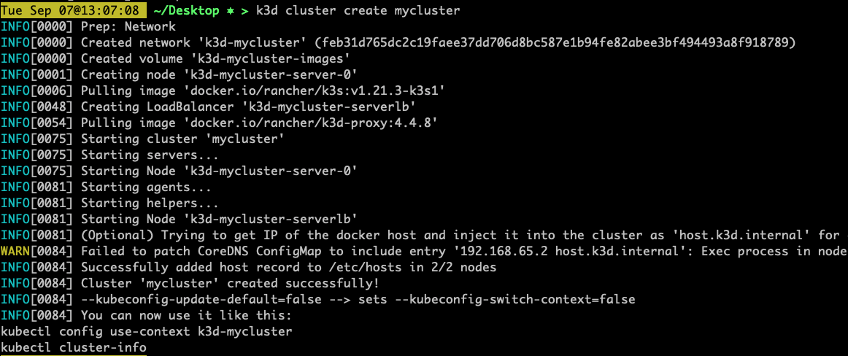
K3s k3d
k3d - Alternative to VM installations
k3d
lightweight wrapper to run k3s in docker
@gkarthics |
Notes:
The alternative way to install the k3s in local without the linux VM is K3D
K3d is a wrapper toi run the k3s in side docker container.
Simply install the k3d binary and execute `k3d cluster create mycluster` to create a k3s cluster inside a docker container

Slide 18
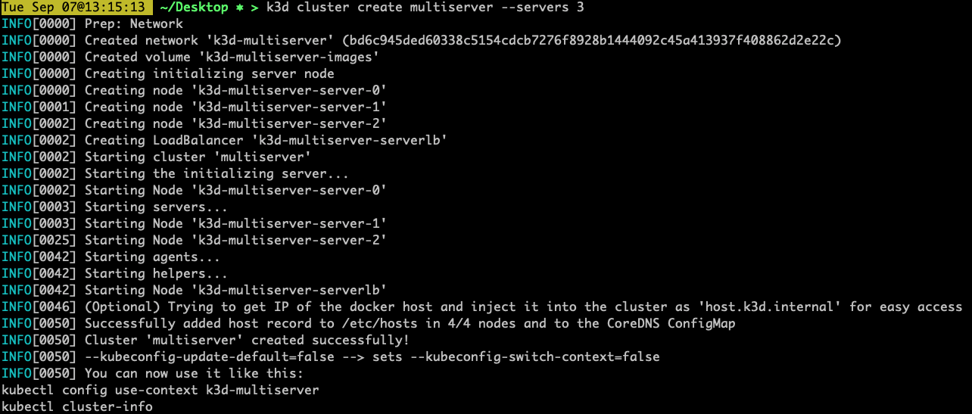
K3s k3d …High Availability
Supports multi node cluster as well
k3d cluster create multiserver --servers 3
Auto clustering in multi-server mode
@gkarthics |
Notes:
Similar to the VM kl3s, the k3d supports the multi-node cluster too.
When you specify the server count as an argument as shown here, you will see the number of nodes getting created.
The advantage of the k3d over any other k8s is that
It creates all the nodes and cluster them automatically.
No manual intervention is necessary for clustering work

Slide 19
K3s k3d …High Availability
multiserver control-plane cluster
k3d cluster create mycluster --registry-create
@gkarthics |
Notes:
For creating the container registry, when executed with the `--registry-create` flag, k3d automatically creates the container registry and exposes on port 5000

Slide 20
K3s ….Observation
Compatible only with Linux (windows)
Needs multipass/vagrant in local (Linux VMs)
k3d
Also run with k3d
Needs docker on the host (for k3d mode)
Additional deployment for lib/registry to run container registry for Images (native k3s)
@gkarthics |
Notes:
With the the observation on the k3s are
Native k3s is compatiable only with the Linux machines
Need either multipass or vagrant like took to create linux VMs
We can run this with K3D
If running with k3d, a docker daemon is mandatory
This is also a CNCF conformant certified distribution

Slide 21
Concepts
Virtual Cluster: A complete Kubernetes Cluster spun up inside an existing Kubernetes Cluster
Host Cluster: An actual Kubernetes Cluster that hosts the virtual kubernetes clusters
Self Servicing K8s Cluster: A developer can login and create their own Kubernetes Cluster on demand
@gkarthics

Slide 22
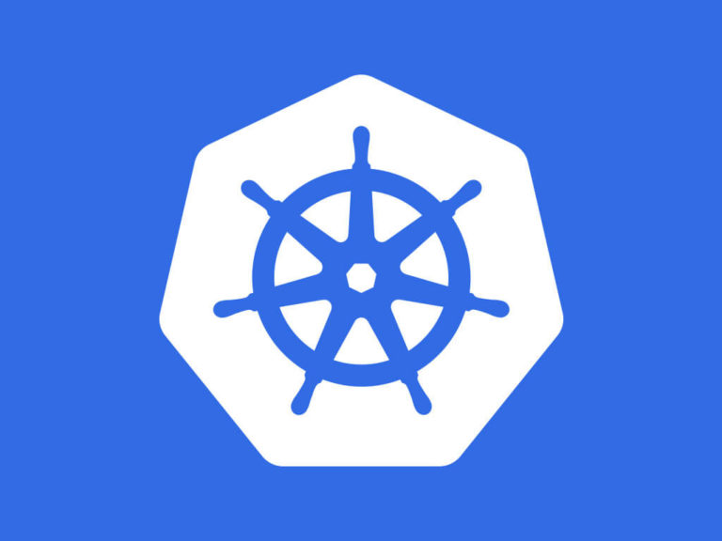
vCluster
Doesn’t create any cluster in local machine
Creates a cluster inside a running K8s cluster
Follows the Kubernetes-IN-Kubernetes concept
Developers works with remote cluster with thin cli
Developers can be (virtual)cluster admin
@gkarthics |

Slide 23
vCluster
CLI works with all OS viz., Mac/Linux/Windows
No container registry is available, as this will purely creates a Kubernetes cluster only
Namespaces and resources created within the virtual cluster will be encapsulated within the host namespace where vCluster runs
Creates an impartial cloud-native developer experience across all OS Developers
@gkarthics |

Slide 24
vCluster
Creation of vCluster doesn’t need admin perms
vcluster create my-vcluster -n host-namespace
vcluster connect my-vcluster -n host-namespace
export KUBECONFIG=./kubeconfig.yaml
kubectl get ns
kubectl get pods -n kube-system
From the host cluster, all the services are sync’d and pods are scheduled from syncer a scheduler handler
@gkarthics |

Slide 25
vCluster ….Observation
A host cluster is mandatory
Provides a remote development environment
Need to deploy our own container registry, as this creates a pure K8s cluster only
Impartial cloud-native developer experience for developers from all OS and machines viz., Mac/Win/Linux and VDIs
@gkarthics |

